Slide 1
Android Programming Class: Graduate Term Project – Team 1
Marcos Davila
Marcus Silveira
Prince Oladimeji
Members:

Slide 2
Project Overview
Project Name: Sheep Herder
This project consists of a game where the user controls a dog, the “Sheep Herder”, and is responsible for keeping the sheep together, avoiding the perils of the dangerous fox that can come at any time.

Slide 3
Description of the Project
Characters Definition
Sheep
Is not allowed to go off the screen
They can go in any direction, and move by reaction to dog’s or fox’s proximity
They are slower than the other animals
Dog
Keeps the sheep safe
Chases the predator away (fox)
Controlled by the user
Fox
Chases sheep to eat them
Runs away from the dog
Appears on the game at random

Slide 4
Description of the Project
Project Features
Representation of each animal and its characteristics
Full screen game with independent rendering (for each set of animals)
User has full control over the dog
Artificial Intelligence for Fox and Sheep to move and react
Three main screens: home screen, settings, and game screen
Ability to control speed of animals (by default: fox’s speed > dog’s > sheep’s)

Slide 5
Description of the Project
Technical Details
Android application that doesn’t need to contact any external service
Implementation of SurfaceView to render in full screen mode
Use of fragments to render top bar with “Back” option
Use of multiple types of UI widgets, including buttons, images, seek bars, and textViews
Use of SharedPreferences to store information among screens
Internationalization (support for Spanish)
Unit and integration tests will use Android Junit Tests / Robotium

Slide 6
Project Design and Navigation
A white round figure will represent a sheep
A green square figure will represent the dog
A red triangular figure would represent a fox
Users can touch the screen on the corners to represent where they want the dog to move (for example, tap anywhere up to move the dog upwards).

Slide 7
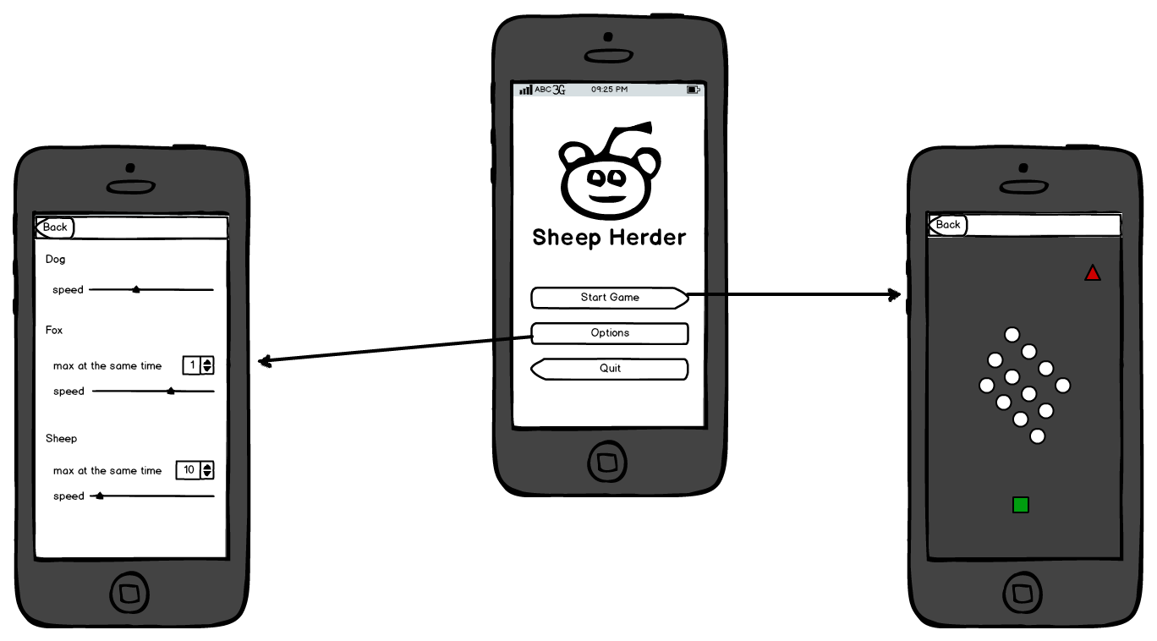
Project Design and Navigation

Slide 8
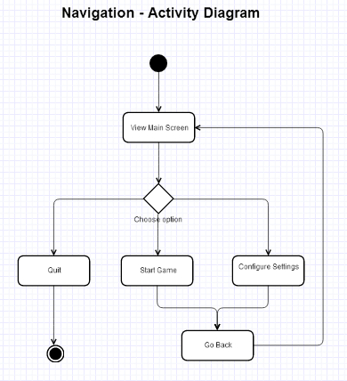
Project Design and Navigation

Slide 9
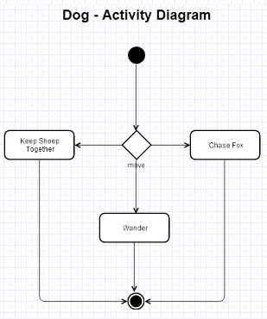
Project Design and Navigation

Slide 10
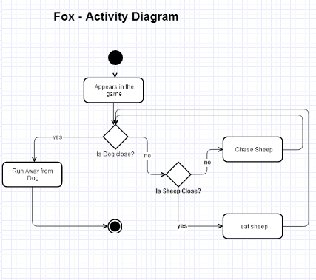
Project Design and Navigation

Slide 11
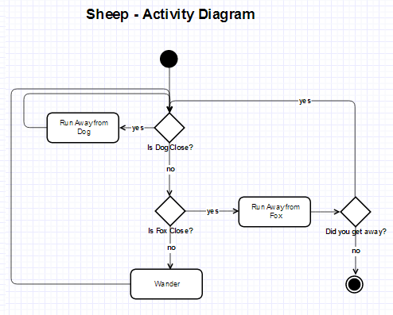
Project Design and Navigation

Slide 12
Project Schedule
Week of Feb 18th
Define requirements
Create a Use Case diagram
Create basic Design and navigation process
Create an initial presentation
Determine the classes, methods and attributes
Create activity diagram
Start with Proof of concept (POC)
Week of March 4th
Finish auxiliary screens (settings and main)
Unit and integration testing on these screens
Week of March 18th
Start work on the game screen (control and render the dog)

Slide 13
Project Schedule
Week of April 1st
Continue work on the game screen (fox and sheep)
Week of April 15th
Continue work on the game screen (fox and sheep)
Week of April 29th
Presenting the program in class
Preparing to package / release
Final touches
Submit code to professor
Week of May 13th
Publishing to the store

Slide 14
QA

Slide 15
Thank you for listening!

